Slide 1
Backtracking

Slide 2
Introduction
Backtracking is a problem-solving algorithmic technique that involves finding a solution incrementally by trying different options and undoing them if they lead to a dead end.
Backtracking is used to explore multiple possibilities in problems such as solving puzzles like Sudoku, by systematically trying different choices.
When a choice leads to a dead end, the algorithm backtracks to the previous decision point and tries a different path, avoiding unnecessary exploration of invalid solutions.

Slide 3
Backtracking-Working
Choose – Start by making a choice that could lead toward a solution.
Explore – Recursively move forward with this choice.
Check validity – If the choice leads to an invalid state, undo it (backtrack) and try another option.
Repeat – Continue this process until all possibilities are explored or a valid solution is found.

Slide 4
Backtracking-Examples
M-Coloring Problem
N Queens Problem

Slide 5
Graph Coloring Problem
It refers to the problem of coloring vertices of a graph in such a way that no two adjacent vertices have the same color.
Also called the vertex coloring problem.
If coloring is done using at most m colors, it is called m-coloring.

Slide 6
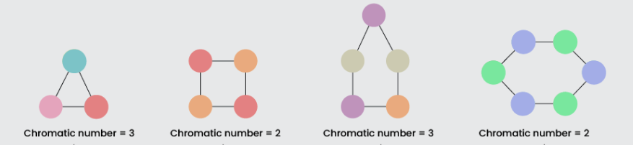
Chromatic Number
The minimum number of colors needed to color a graph is called its chromatic number.

Slide 7
Graph Coloring Problem-Example
Let us color this following graph using 3 colors: {R,G,B}
1
2
4
3

Slide 8
Applications
Map coloring.
Designing a timetable.

Slide 9
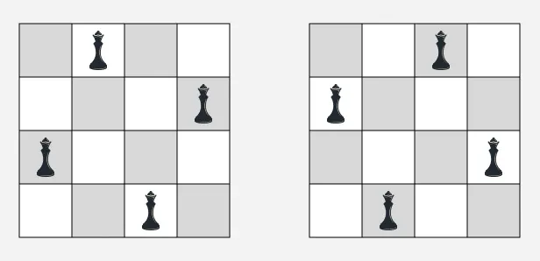
N Queens Problem
In the N-Queens problem, the goal is to place N queens on an N×N chessboard so that no two queens attack each other (same row, column, or diagonal).

Slide 10
N Queens Problem
Use backtracking to place queens row by row, checking if each position is safe. If safe, place the queen and move to the next row; otherwise, backtrack and try another position. Store the solution when all queens are placed.

Slide 11
N Queens Problem-Example
1 2 3 4
1
2
3
4
Given queens: Q1, Q2, Q3, Q4

Slide 12
Applications
Robotic Path Planning.
Solving complex constraint-based puzzle problems.

Slide 13
When to use Backtracking
Constraint satisfaction problems: When you need to build a solution step by step and must satisfy certain conditions (e.g., N-Queens, Sudoku, Rat in a Maze).
Search problems: When the solution space is large, but invalid or infeasible branches can be pruned early.
Multiple solutions: When you need to explore all possible valid solutions, not just one.
Combinatorial problems: When you must generate all valid combinations, permutations, or subsets under constraints.

Slide 14
When not to use Backtracking
No pruning possible: If all branches must be explored anyway (no constraints to cut early), brute force or iterative methods may be simpler.
Large input size: Backtracking can be exponential in time. For very large inputs without strong pruning opportunities, it becomes impractical.
Single optimal solution: If the task only needs one best solution with clear optimization criteria, algorithms like DP, greedy, or graph search may be faster.

Slide 15
Thank You

